Slide 1
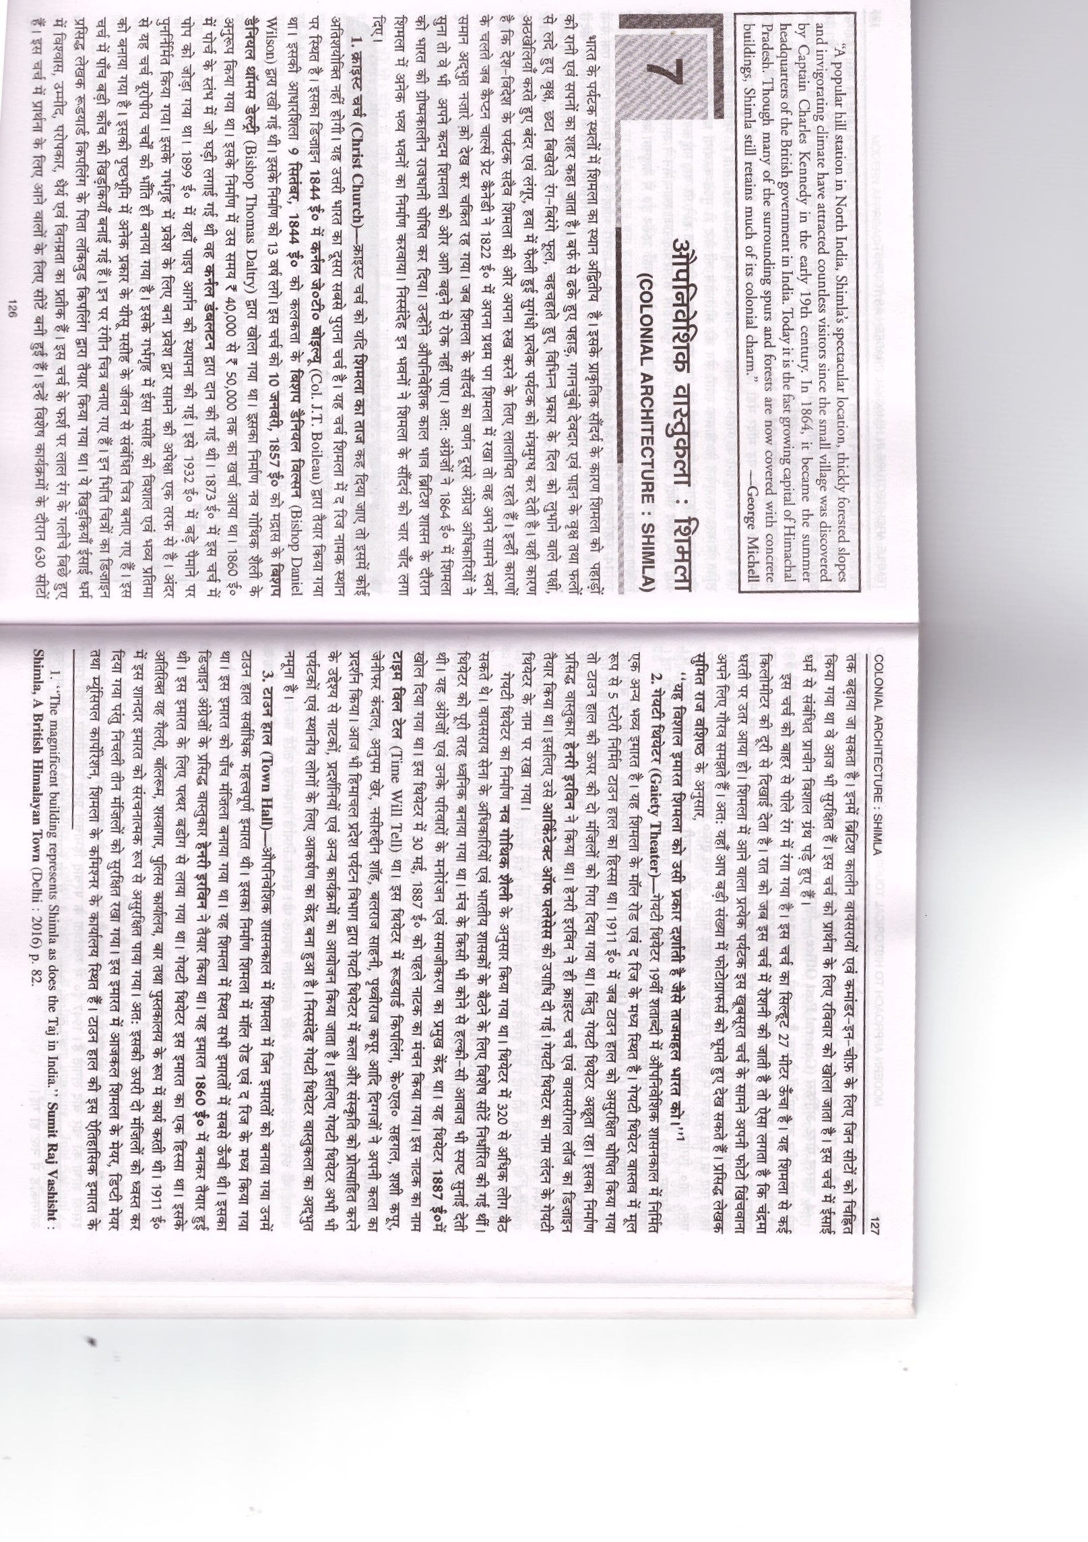
COLONIAL ARCHITECTURE: SHIMLA

Slide 3
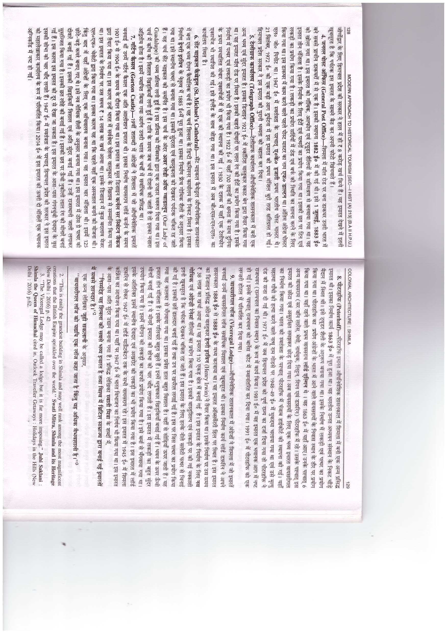

Slide 5
